Slide 1
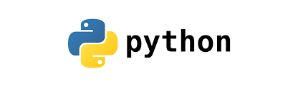

50 Days of Challenge
1) Current affairs Quiz app and Company Name Generator
2) Treasure Hunt application
3) Game simulator: Rock-Paper-Scissor app
4) Password (Strong) generator app
5) Mysterious maze escape app
6) Tea-vending machine (Using OOPs concepts)
7) Interactive Snake Game (GUI based)
8) Password manager app (using Tkinter)
NOTE: These are tentative projects, we will adapt according to your grasp of the concepts.

Slide 2
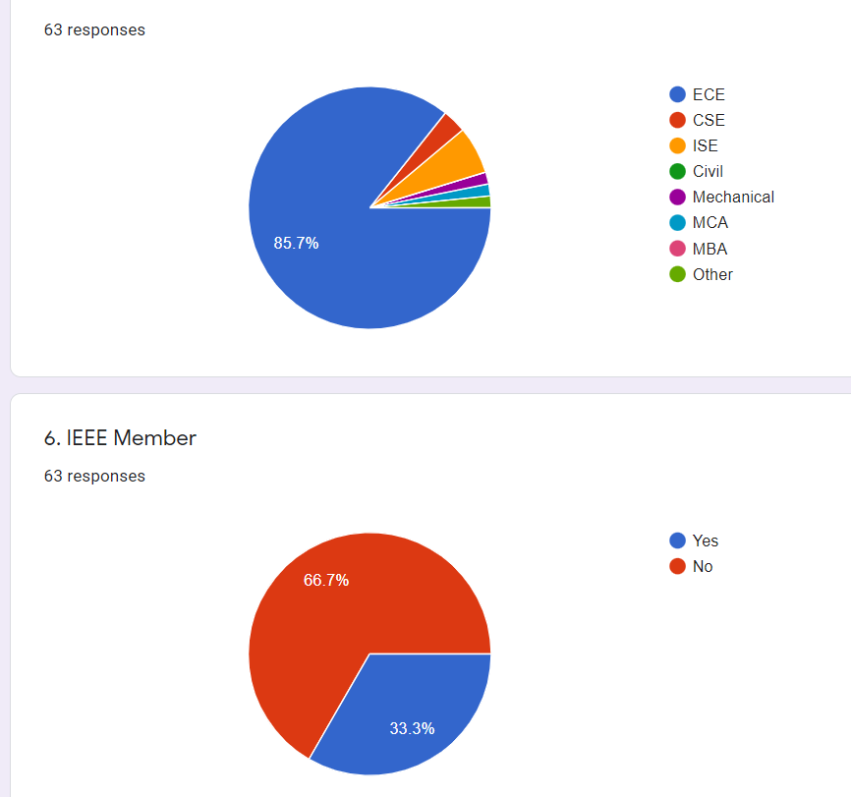
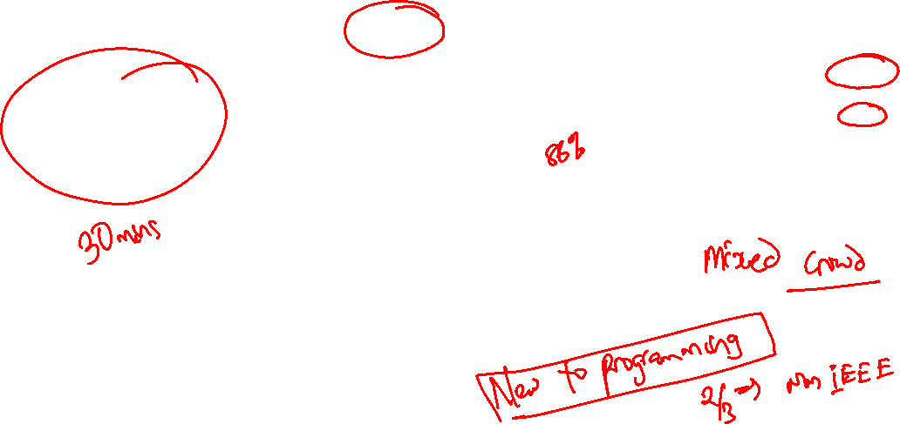
Where we stand?

Slide 3
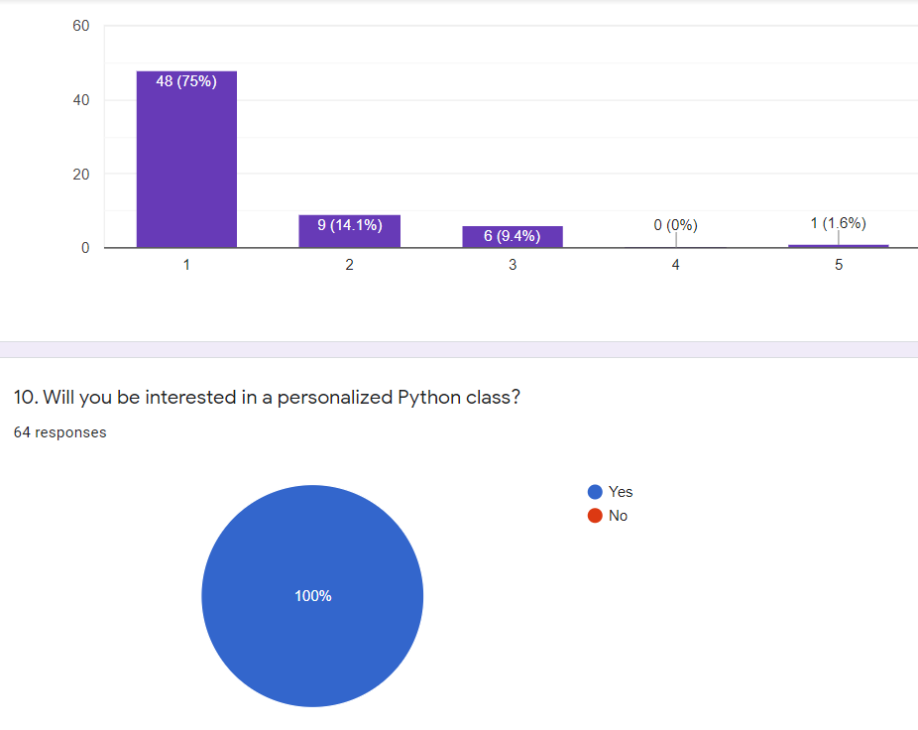
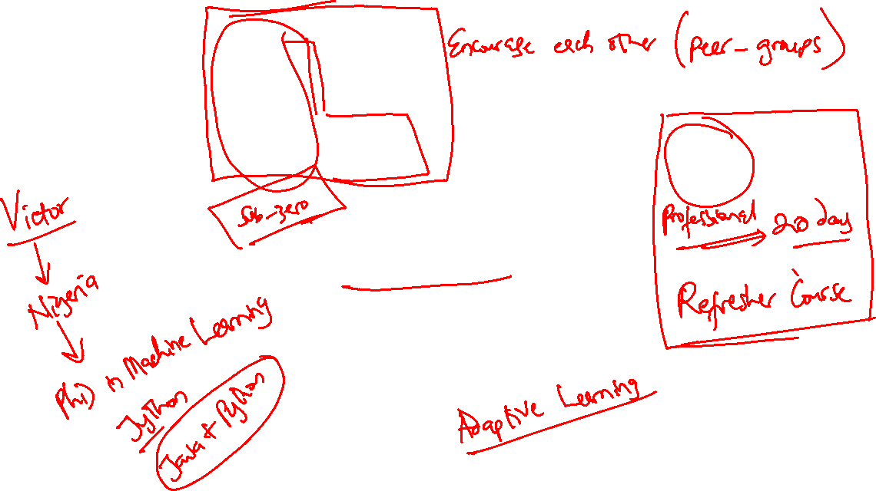

Slide 4
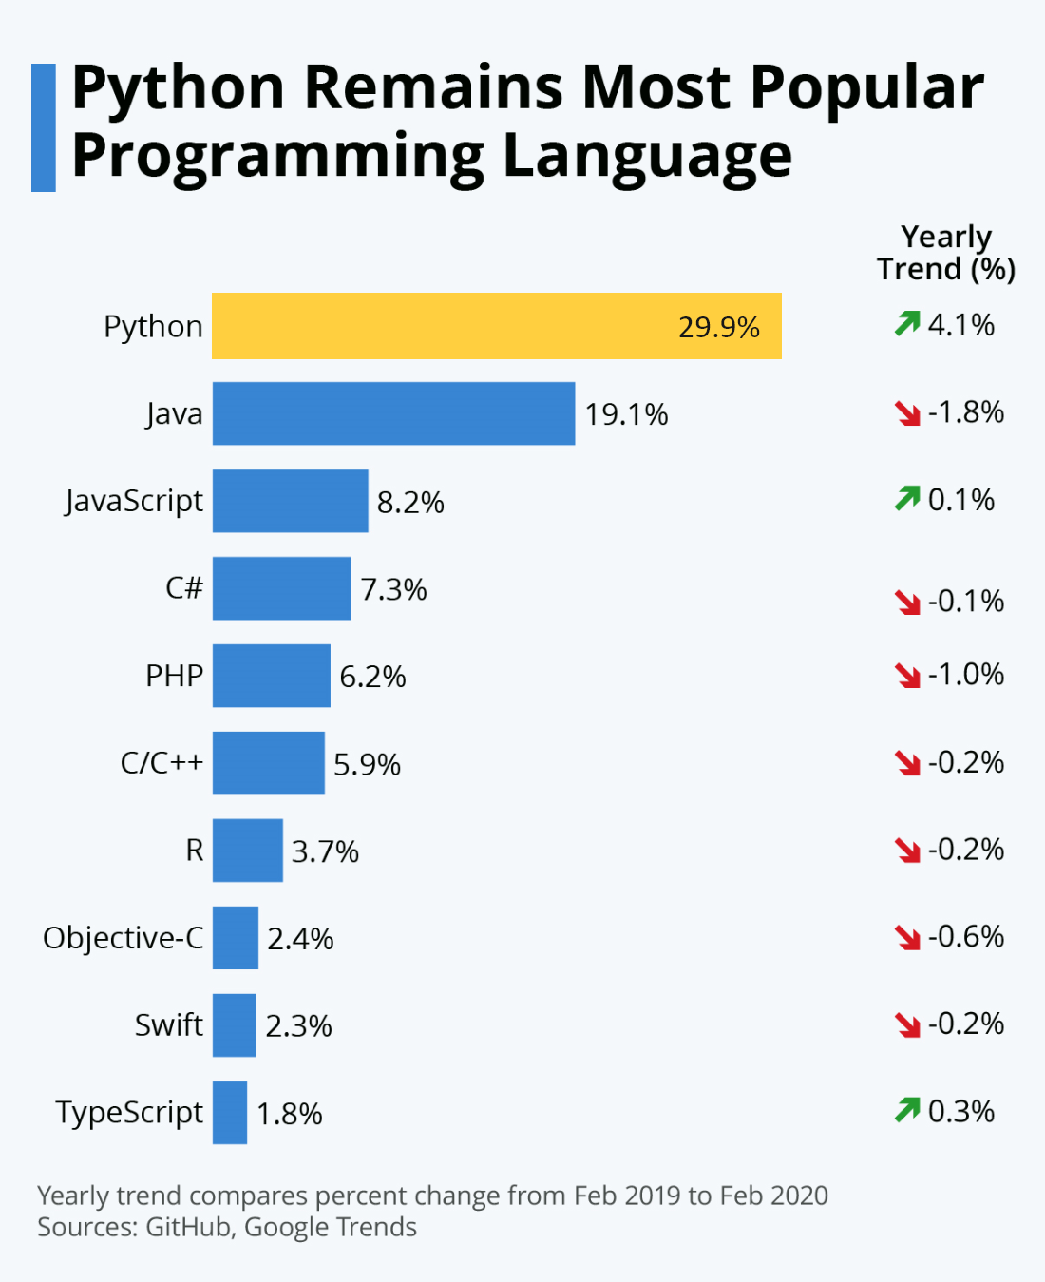
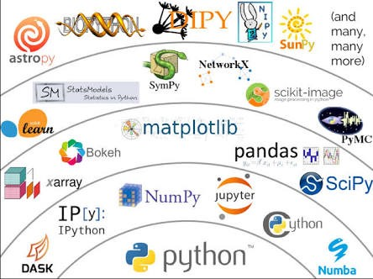
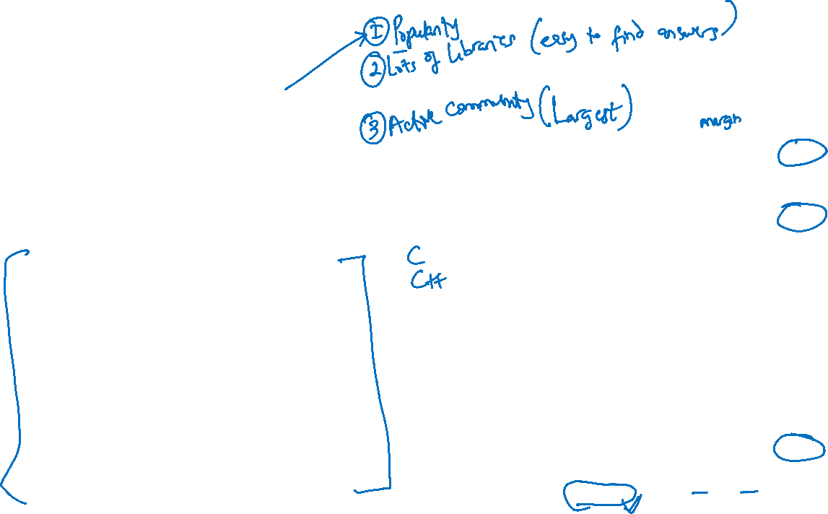
Why Python?

Slide 5
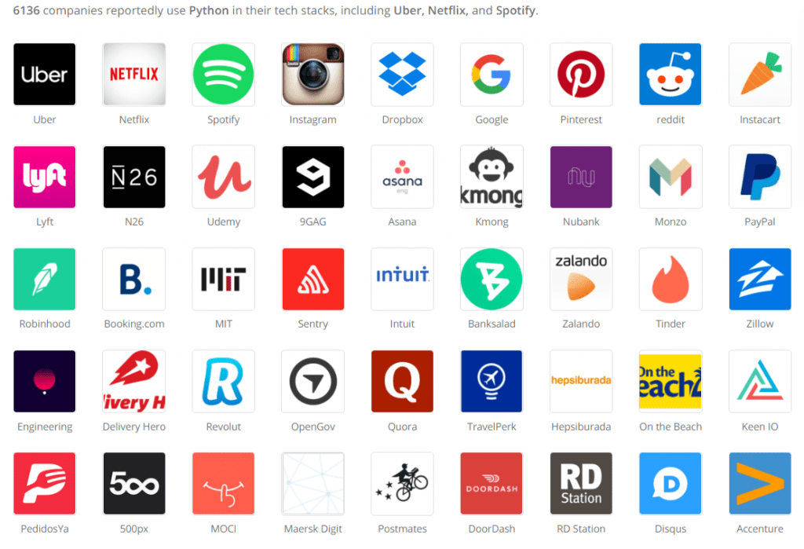

Slide 6
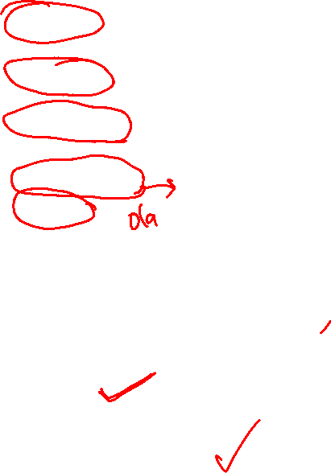
Top 15 websites developed in Python
Netflix: The world's most popular streaming website, was built with Python.
Google: Another popular website using Python is Google.
YouTube: A sister concern of Google, YouTube was majorly written in Python
Instagram
Uber
Pinterest
Dropbox
Quora
Spotify
Reddit
Yahoo
Instacart
Survey Monkey
Discus
Bitly

Slide 7

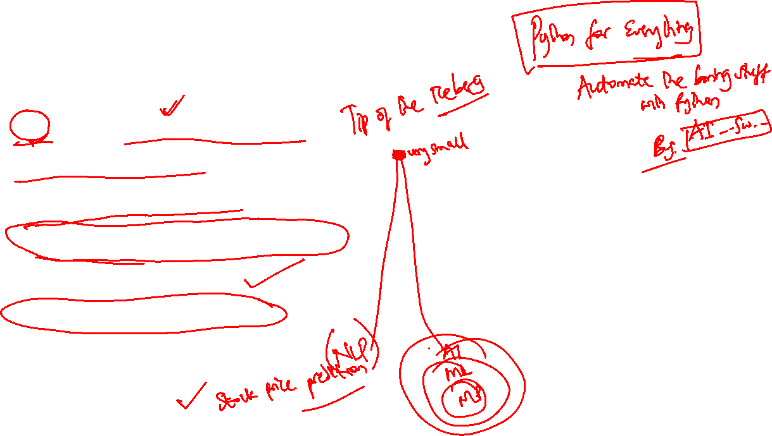
What can you do with Python?
Python can be used for:
AI and machine learning
Data analytics
Data visualization
Programming applications
Web development
Game development
Language development
Finance etc.

Slide 8
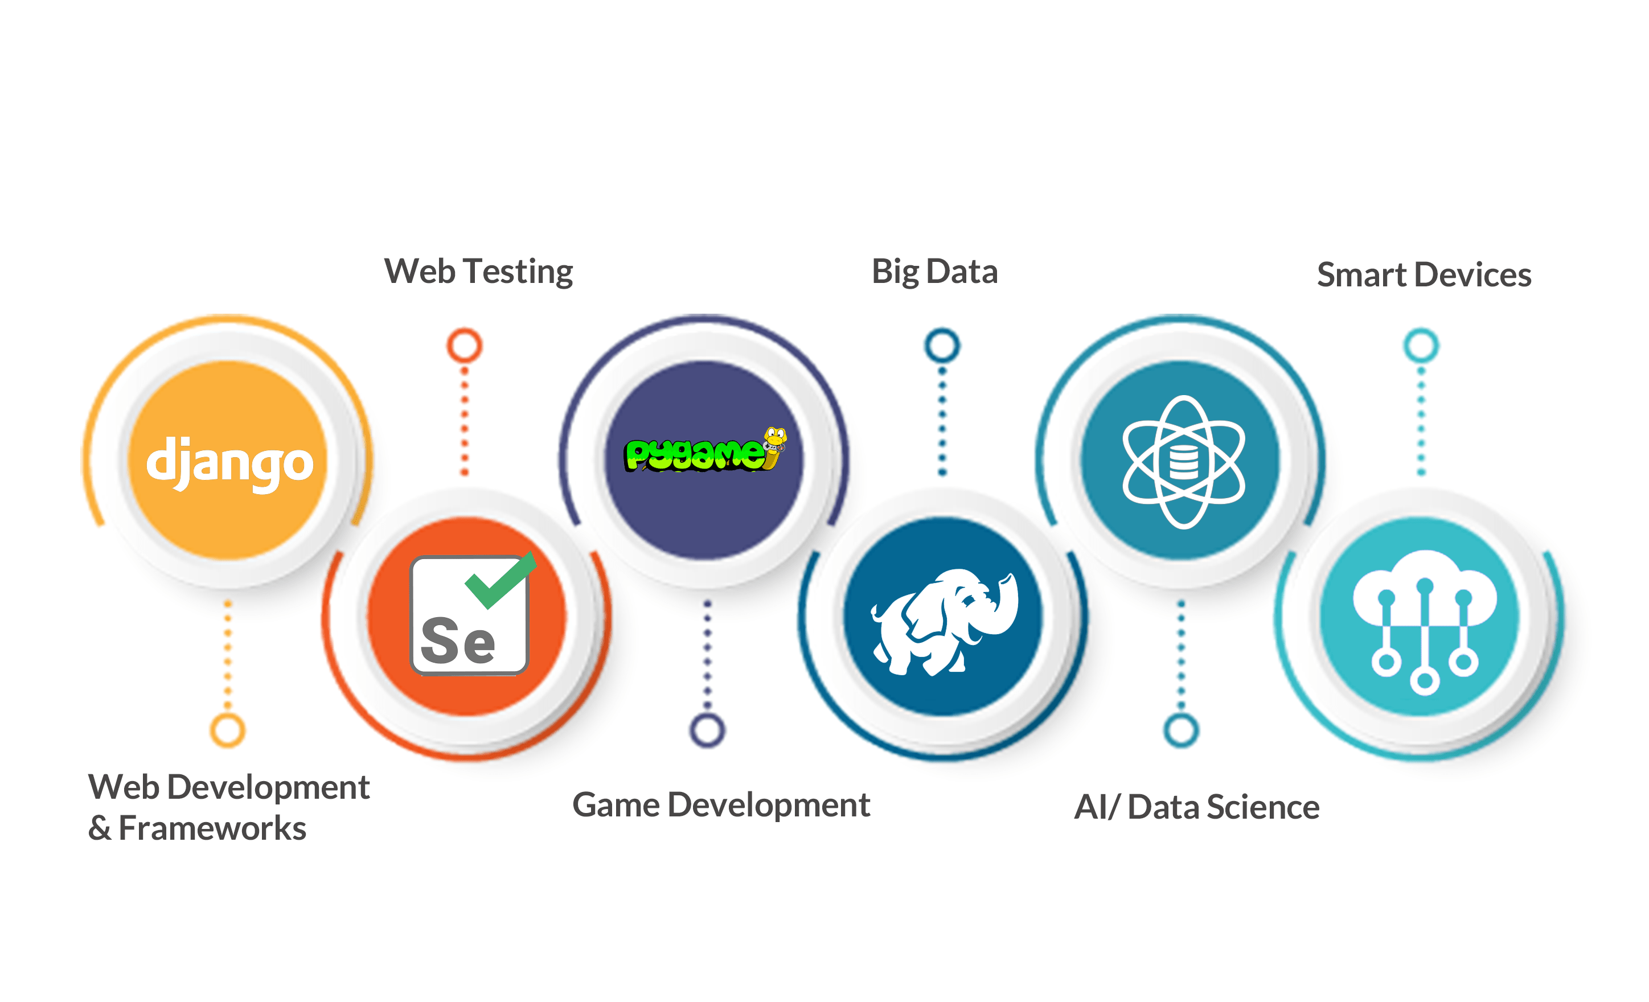
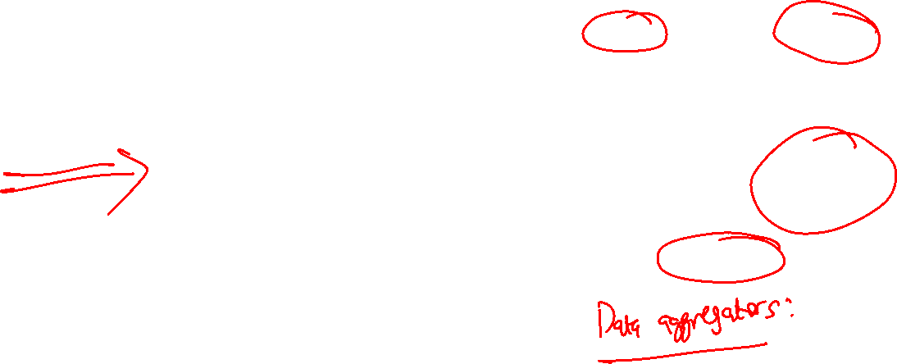
Career Path in Python

Slide 9
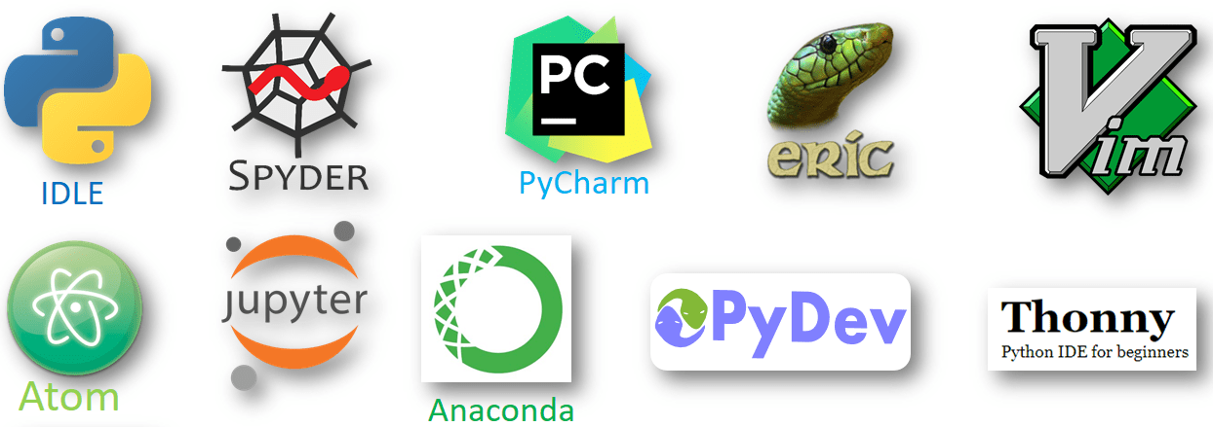
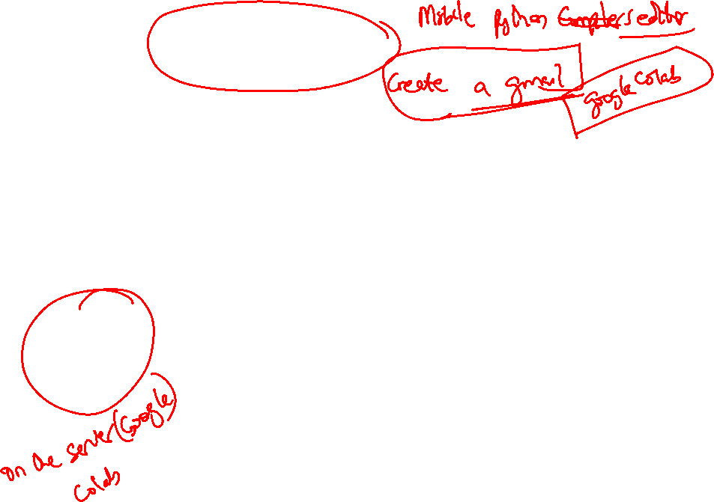
Python IDES vs Online IDES?

Slide 10

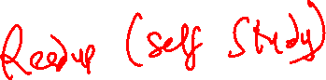
Anything Else?

Slide 11
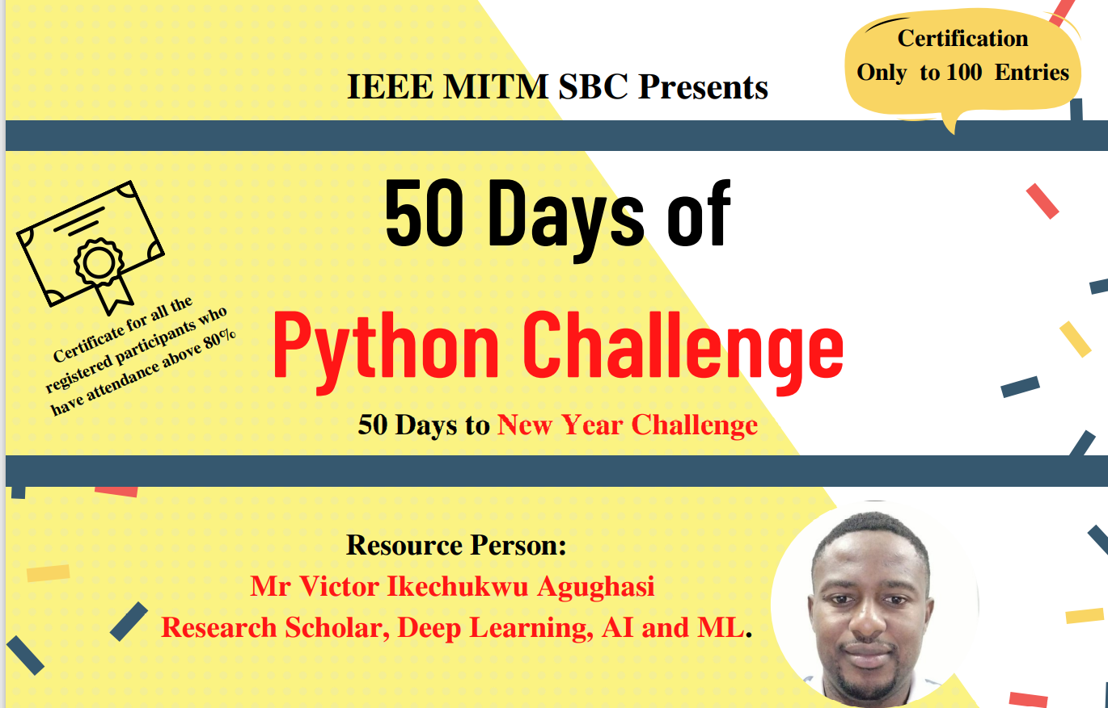
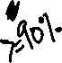

Slide 12
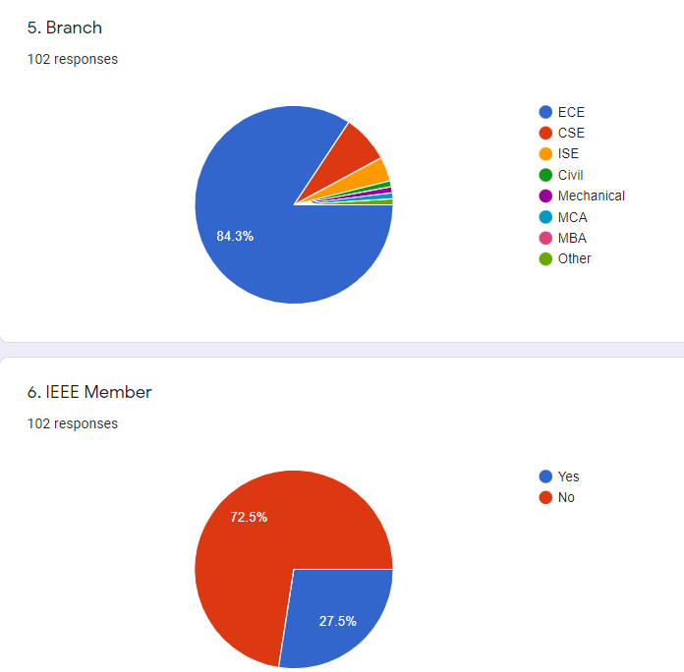
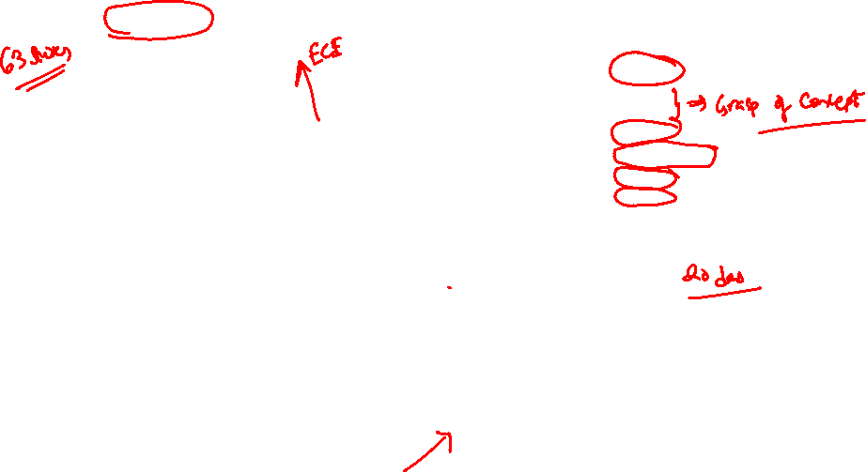
Where do we stand?

Slide 13
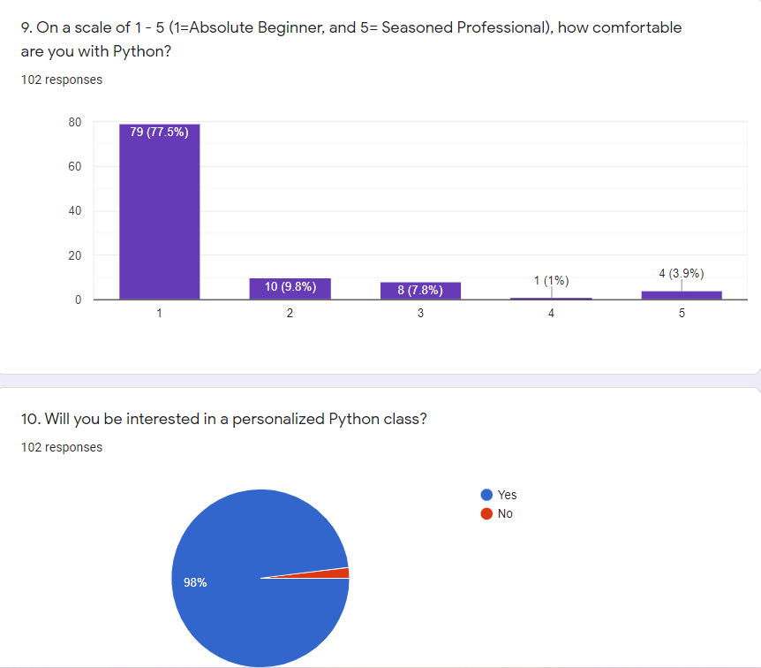
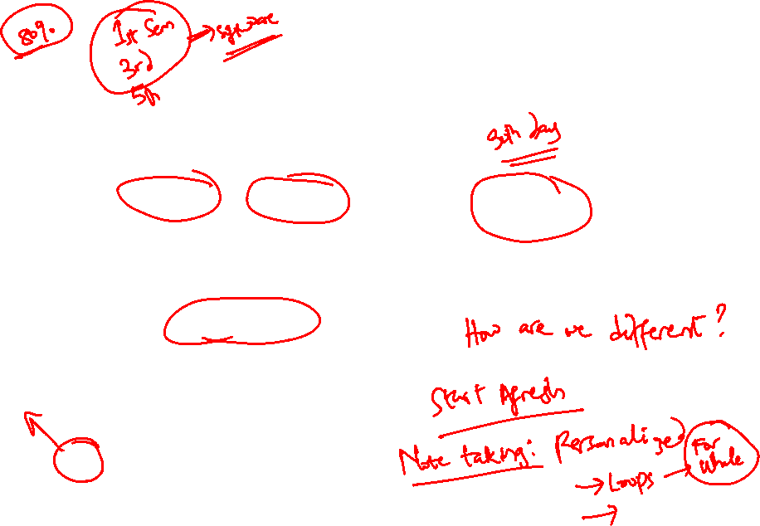

Slide 14

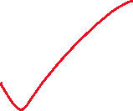
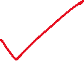
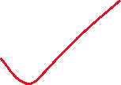
Day 2 of 50 Days to the New Year Challenge
OUTLINE
Python vs other programming languages
IDLE vs Online Compilers
Concepts of Variables, Strings, Keywords and naming rules
Demo:
Basic programs in Python

Slide 15
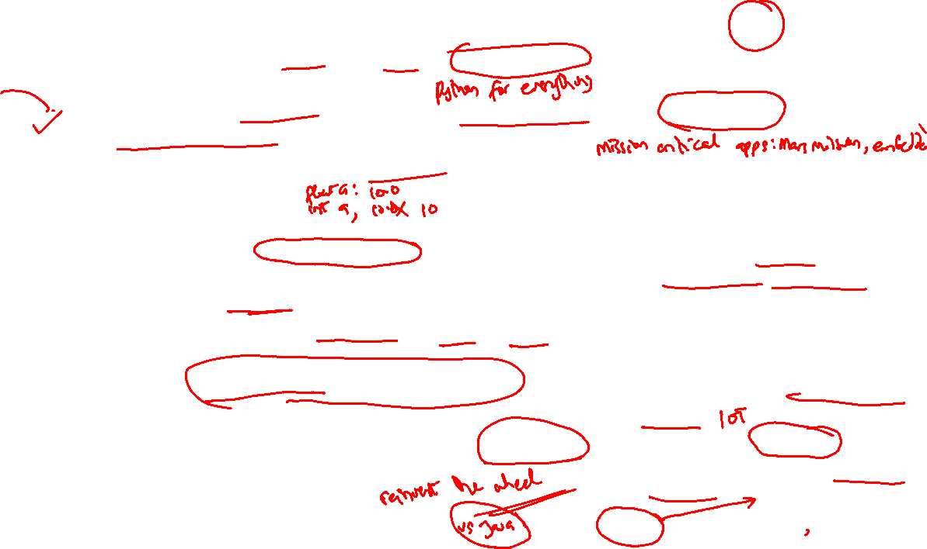
METRICS | Python | C
Introduction | Python is an interpreted, high-level, general-purpose programming language. | C is a general-purpose, procedural computer programming language.
Ease of Use | It is easier to write a code in Python as the number of lines is less comparatively. | Program syntax is harder than Python.
Speed of execution | Interpreted programs execute slower as compared to compiled programs. | Compiled programs execute faster as compared to interpreted programs.
Variables | There is no need to declare the type of variable. Variables are untyped in Python (Dynamically typed). A given variable can be stuck on values of different types at different times during the program execution | In C, the type of a variable must be declared when it is created, and only values of that type must be assigned to it.
Complexity | Syntax of Python programs is easy to learn, write and read. | The syntax of a C program is harder than Python.
Applications | Python is a General-Purpose programming language. | C is generally used for hardware related applications.
Data Structures | Gives ease of implementing data structures with built-in insert, append functions. | Implementing data structures requires its functions to be explicitly implemented
Pointers | No pointers functionality available in Python. | Pointers are available in C.

Slide 16
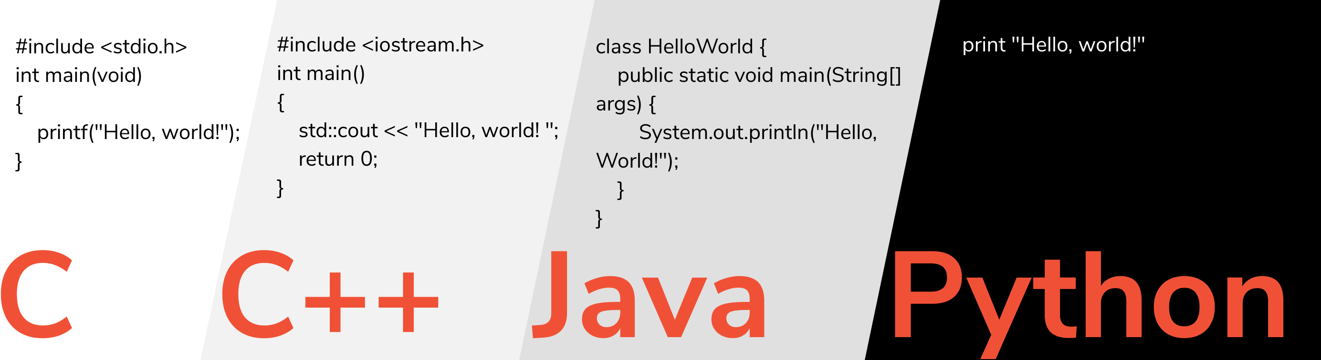
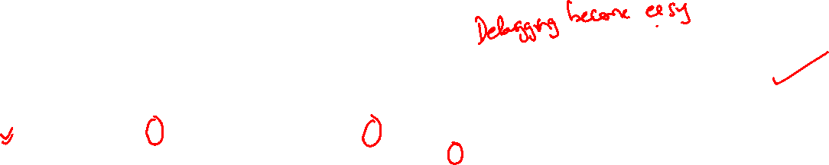
Python vs other languages

Slide 17
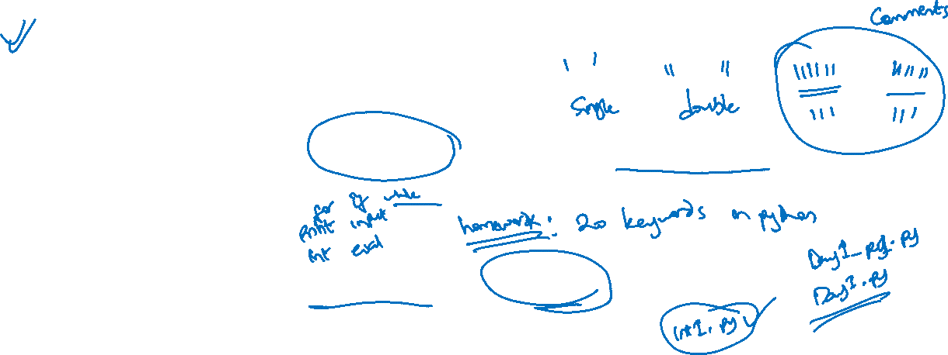
Variables, Strings, Keywords & naming rules
Variables: Values can be stored I variables to simplify calculations
Strings in python are surrounded by either single quotation marks, or double quotation marks.
'hello' is the same as "hello".
Python has a set of keywords that are reserved words that cannot be used as variable names, function names, or any other identifiers.
The name of a variable/filename must not be a Python keyword

Slide 18
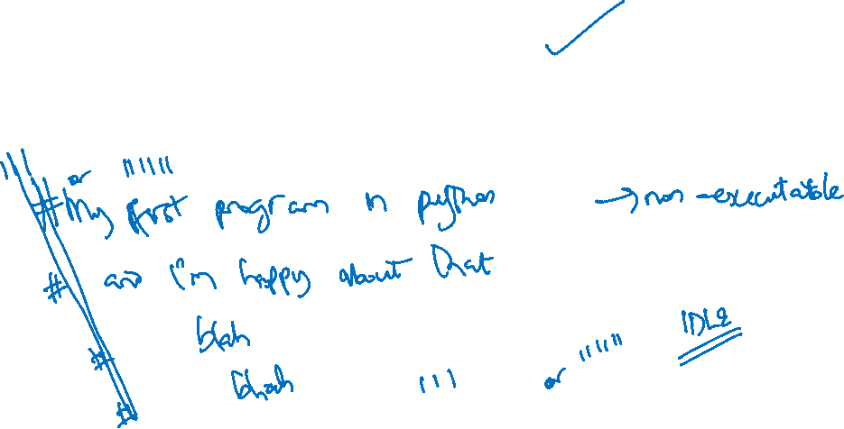
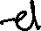
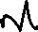
Comments in Python
Use of Single line Comment (#)
Multiline comments using triple quotes (“”” blah blah blah“””)

Slide 19


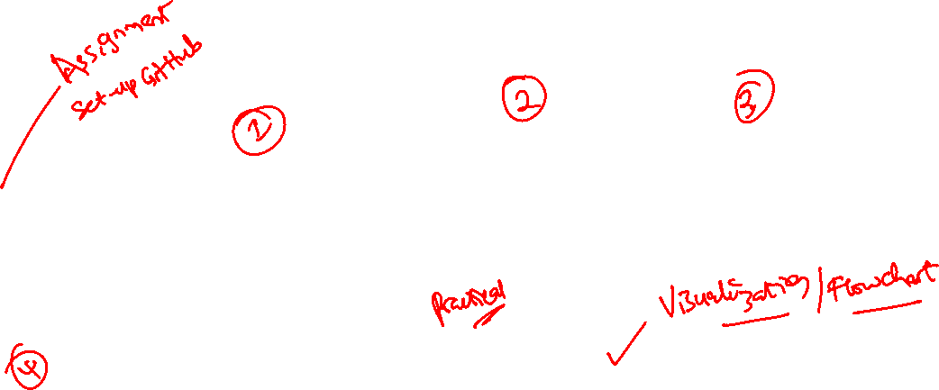






3 of 50 Days of Python Programming
OUTLINE
Python as a calculator
Use of magic variables
Keyboard Shortcuts
Getting user inputs
Demo / Homework
Flow Control

Slide 20
4 of 50 Days of Python Programming
1.) Magic Variables & Methods in Python
2.) Operators:
i)Comparative and Boolean (Truth Tables)
3.) Flow Control:
i)Conditions and Code Blocks
4.) While Loop:
i)Irritating and infinite loops
5.) Homework

Slide 21
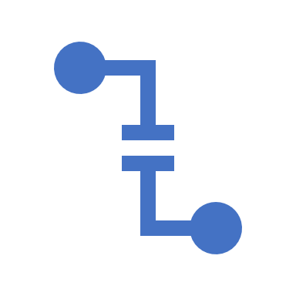
5 of 50 Days of Python Programming
1) Nested-IF
2) Pass Statement
3) Switch Case in Python
4) FOR Loop
5) The Loop Variable
6) The range function
7) Homework: WAP that prints a giant letter A.

Slide 22
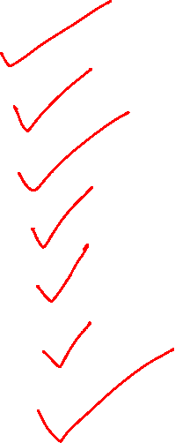
5 of 50 Days of Python Programming
1) Nested-IF
2) Pass Statement
3) Switch Case in Python
4) FOR Loop
5) The Loop Variable
6) The range function
7) Homework: WAP that prints a giant letter A.

Slide 23
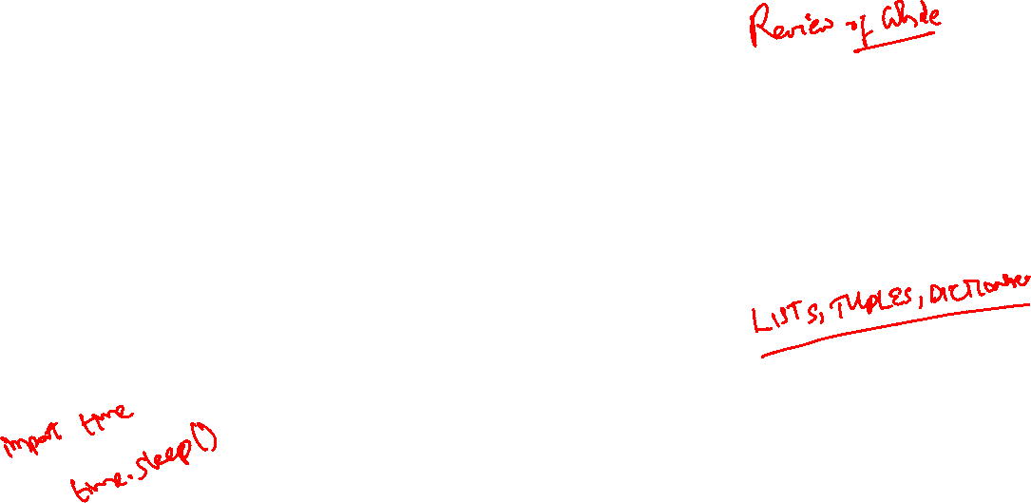
Day 6 of 50 Days of Python Programming
1) Some While Examples
2) Use of sys.exit()
3) Strings (Concatenation and Repetition)
4) Slicing
5) Assignments
Next Class: Read up Functions

Slide 24
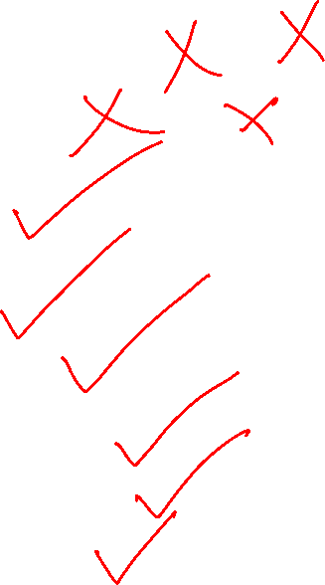
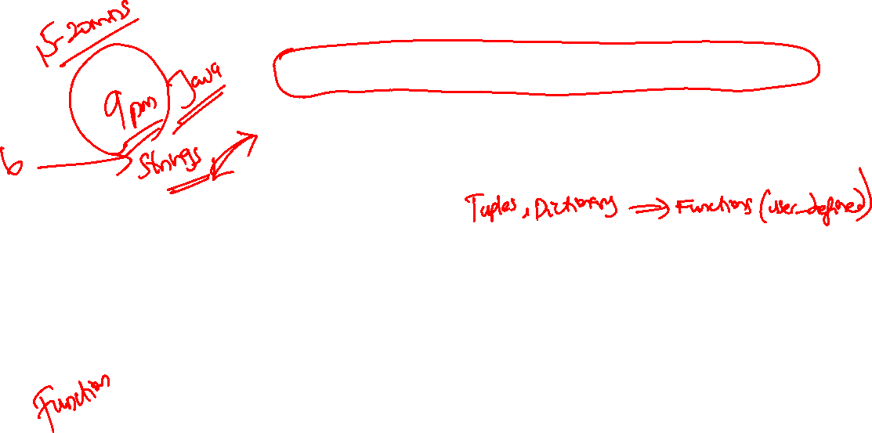
Day 7 of 50 Days of Python Programming
Version control Using Git vs GitHub
Creating an account, cloning etc
Basics of Lists (Input, Empty & Long lists)
Lists vs Strings & built-in functions
List methods
Making copies & changing lists
Demo (Examples)
Homework

Slide 25
Day 7 of 50 Days of Python Programming
Version control Using Git vs GitHub
Creating an account, cloning etc
Basics of Lists (Input, Empty & Long lists)
Random module in list
Lists vs Strings & built-in functions
List methods
Making copies & changing lists
Demo (Examples)
Homework

Slide 26
Day 8 of 50 Days of Python Programming
1. Assignment Revision
2. Git vs GitHub Tutorial
3. Joins (Opposite of Split)
3. List Comprehension
4. Two-Dimensional lists
5. Demo (Examples)
6. Assignments!!

Slide 27
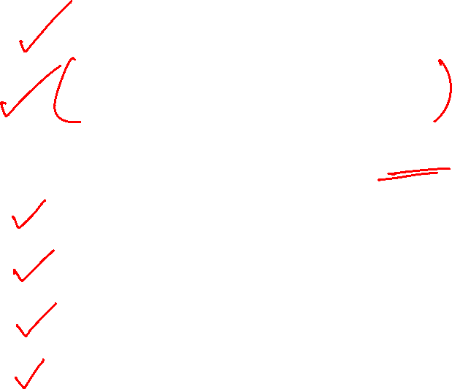
Day 8 of 50 Days of Python Programming
1. Assignment Revision
2. Git vs GitHub Tutorial
3. Joins (Opposite of Split)
3. List Comprehension
4. Two-Dimensional lists
5. Demo (Examples)
6. Assignments!!

Slide 28
Anything Else?

